Slide 1


INTERNATIONAL INFORMATICS OLYMPIAD IN TEAMS
PIATRA-NEAMȚ
ROMANIA
24-29 MAY 2026
Notes:
1

Slide 2


NATIONAL SCIENTIFIC COMMITTEE
NR. CRT. | NAME AND SURNAME | POSITION | INSTITUTION
1. | Prof. univ. dr. Adrian Iftene | President | U.A.I.C Iași, Faculty of Computer Science, Iași
2. | Georgeta Antonia Rodica Crăciunescu | Executive president | Ministry of Education and Research, Bucharest
3. | Nușa Dumitriu-Lupan | Honorary president | Children's Palace Bârlad, Vaslui County
4. | Livia Demetra Țoca | Scientific secretary | National Centre of Policies and Evaluation of Education/National College of Computer Science „Tudor Vianu”, Bucharest
5. | Ionuț-Liviu Ciocoiu | President of the organisating committee | Neamț County School Inspectorate
6. | Adrian Panaete | President of the scientific committee | A.T. Laurian Botoșani National College
7. | Daniela Neamțu | Secretary | National College of Computer Science Piatra-Neamț
8. | Vasile Diaconu | Secretary | National College of Computer Science Piatra-Neamț

Slide 3
NATIONAL SCIENTIFIC COMMITTEE
Nr. crt. | Name and Surname | Position | Institution
1. | Florentina Ungureanu | Vicepresident of scientific subcommittee | Neamț County School Inspectorate
2. | Dana Lăcrămioara Păiuș | Vicepresident of organisational committee | Neamț County School Inspectorate
3. | Ana Socea | Vicepresident of organisational committee | Neamț County School Inspectorate
4. | Gabriel-Marian Huțanu | Vicepresident of technical committee | National College of Computer Science Piatra-Neamț

Slide 4
MEMBERS OF THE SCIENTIFIC SUBCOMMITTEE
NR. CRT. | NAME AND SURNAME | POSITION | INSTITUTION
1. | Ștefan Cosmin Dăscălescu | Member of International Scientific Committee | IIOT International Scientific Olympiad Committee, Croatia
2. | Ema Cerchez | teacher | “Emil Racoviță” National College lași
3. | Paul Diac | professor | “Alexandru Ioan Cuza” University lași, Faculty of Computer Science
4. | Marinel Șerban | teacher | “Emil Racoviță” National College lași
5. | Szabo Zoltan | teacher | Mureș County School Inspectorate
6. | Gheorghe Manolache | teacher | National College of Computer Science Piatra-Neamț
7. | Tiberiu Cozma | student | “Alexandru Ioan Cuza” University lași, Faculty of Computer Science

Slide 5
MEMBERS OF THE SCIENTIFIC SUBCOMMITTEE
NR. CRT. | NAME AND SURNAME | POSITION | INSTITUTION
8. | Andrei Mihai Ciobanu | student | “Alexandru Ioan Cuza” University lași, Faculty of Computer Science
9. | Cristian Luchian | student | “Alexandru Ioan Cuza” University lași, Faculty of Computer Science
10. | Matei Ionescu | student | “Alexandru Ioan Cuza” University lași, Faculty of Computer Science
11. | Andrei Enachescu | student | “Alexandru Ioan Cuza” University lași, Faculty of Computer Science
12. | Matei Ionuț Haba | student | National University of Science and Technology Bucharest, Faculty of Automatisation and Computers
13. | Andrei Cherteș | student | National University of Science and Technology Bucharest, Faculty of Automatisation and Computers
14. | Ioana-Maria Cosma | professor | “Spiru Haret” National College Bucharest Municipal School Inspectorate

Slide 6
ON-LINE MEMBERS OF THE SCIENTIFIC SUBCOMMITTEE
NR. CRT. | NAME AND SURNAME | POSITION | INSTITUTION
1. | Cristian Tanase | student | “Alexandru Ioan Cuza” University lași, Faculty of Computer Science
2. | Alexandru Gheorghieș | student | “Alexandru Ioan Cuza” University lași, Faculty of Computer Science
3. | Bogdan-Ioan Popa | student | Just 4Kids Theoretic Highschool, Bucharest
4. | Alex-Robert David | student | Babeș-Bolyai University Cluj-Napoca, Faculty of Mathematics and Computer Science
5. | Alexandra-Loana Moroz | student | Babeș-Bolyai University Cluj-Napoca, Faculty of Mathematics and Computer Science
6. | Andrei-Cristian Ivan | student | National University of Science and Technology Politehnica Bucharest, Faculty of Automatisation and Computers
7. | Alin-Gabriel Răileanu | student | “Alexandru Ioan Cuza” University lași, Faculty of Computer Science

Slide 7
ON-LINE MEMBERS OF THE SCIENTIFIC SUBCOMMITTEE
NR. CRT. | NAME AND SURNAME | POSITION | INSTITUTION
8. | Robert-Andrei Popa | student | “Alexandru Ioan Cuza” University lași, Faculty of Computer Science
9. | Luca-Stefan Camburu | student | Ecole Polytechnique, Palaiseau - Paris
10. | Daniel Gheorghe | student | University of Bucharest, Faculty of Mathematics and Computer Science
11. | Andrei Lețu | student | Babeș-Bolyai University Cluj-Napoca, Faculty of Mathematics and Computer Science
12. | Robert-Sebastian Moldovan | student | Babeș-Bolyai University Cluj-Napoca, Faculty of Mathematics and Computer Science
13. | Raul Ardelean | student | Babeș-Bolyai University Cluj-Napoca, Faculty of Mathematics and Computer Science
14. | Ștefan-Alexandru Nuță | student | National University of Science and Technology Politehnica Bucharest, Faculty of Automatisation and Computers

Slide 8
ON-LINE MEMBERS OF THE SCIENTIFIC SUBCOMMITTEE
NR. CRT. | NAME AND SURNAME | POSITION | INSTITUTION
15. | Petruț-Rareș Gheorghieș | student | National University of Science and Technology Politehnica Bucharest, Faculty of Automatisation and Computers
16. | Vlad-Mihai Bogdan | student | University of Bucharest, Faculty of Mathematics and Computer Science
17. | David Vișan | student | Southern University of Denmark Sønderborg
18. | Ștefan-Claudel Neagu | student | University of Bucharest, Faculty of Mathematics and Computer Science
19. | Gabriel Turbincă | student | “Alexandru Ioan Cuza” University lași, Faculty of Computer Science
20. | Eduard-Lucian Pîrțac | student | “Alexandru Ioan Cuza” University lași, Faculty of Computer Science
21. | Răzvan-Alexandru Rotaru | student | “Alexandru Ioan Cuza” University lași, Faculty of Computer Science

Slide 9
MEMBERS OF THE TECHNICAL SUBCOMMITTEE
NR. CRT. | NAME AND SURNAME | POSITION | INSTITUȚIA
1. | Petru Simion Oprița | teacher | “Regina Maria” Highschool Dorohoi, Botoșani County
2. | Sanda Bogdan | teacher | “Alexandru Papiu Ilarian” National College Tg. Mureș, Mureș County
3. | Cosma Cătălin | IT specialist | Ministry of Education and Research, Bucharest
4. | Lidia Gabriela Rășcanu | teacher | Vaslui County School Inspectorate
5. | Daniela Tătaru | teacher | “Alexandru Ghica” Theoretic Highschool Alexandria, Teleorman County
6. | Daniel Dorobanțu | IT specialist | National College of Computer Science Piatra-Neamț
7. | Alexandru Dan-Stachie | IT specialist | Neamț County School Inspectorate
8. | Oltianu Radu-Nicolae | IT specialist | Neamț County School Inspectorate
9. | Silvia-Ioana Morțe | teacher | National College of Computer Science Piatra-Neamț

Slide 10

REGULAR MEMBERS

Slide 11


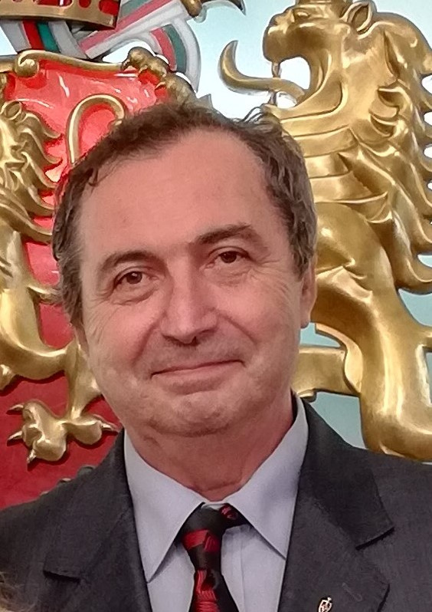
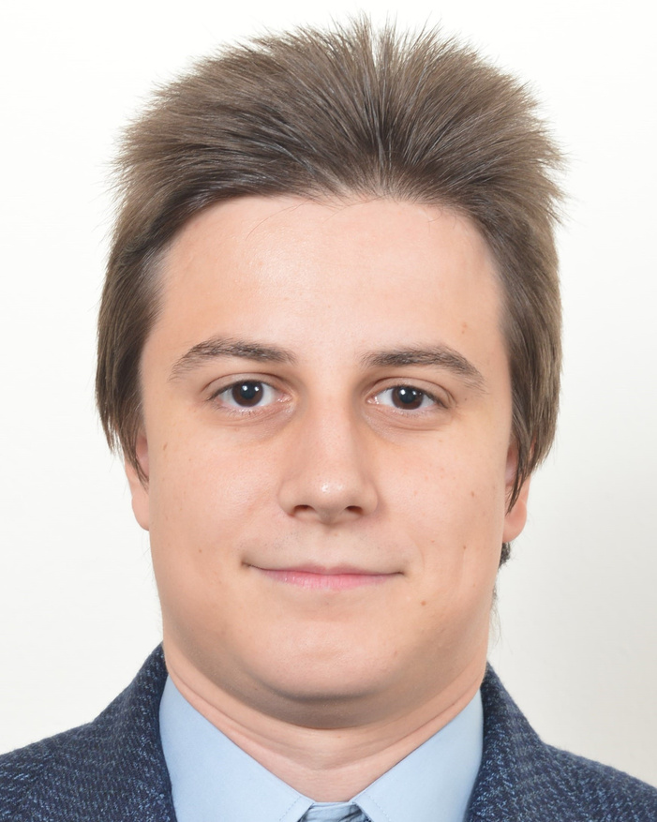
BULGARIA
COMMITTEE MEMBERS
ATANAS YOVCHEV
ILIYAN YORDANOV

Slide 12
COMMITTEE MEMBERS
Atanas Yovchev
School/Organization: Bulgarian National Informatics Committee
National representative

Slide 13
COMMITTEE MEMBERS
Iliyan Yordanov
School/Organization: Bulgarian National Informatics Committee
National representative

Slide 14

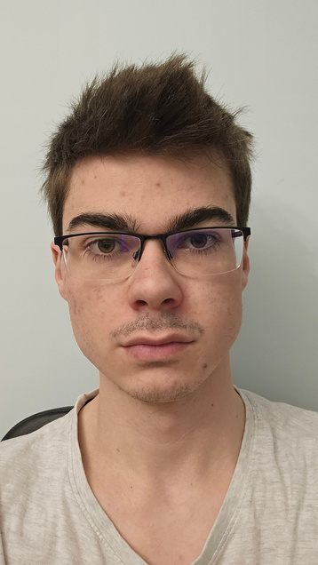
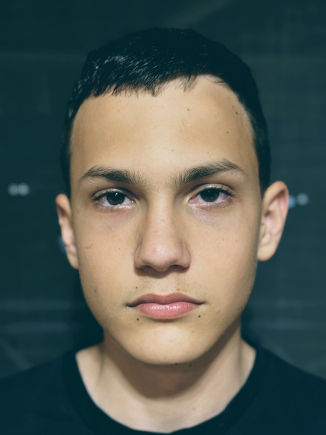
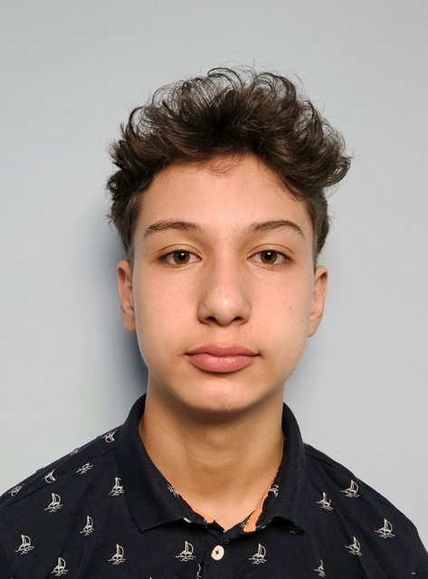
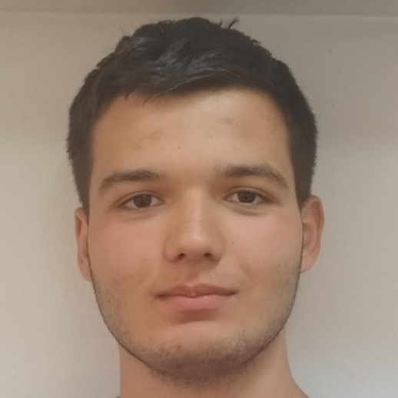
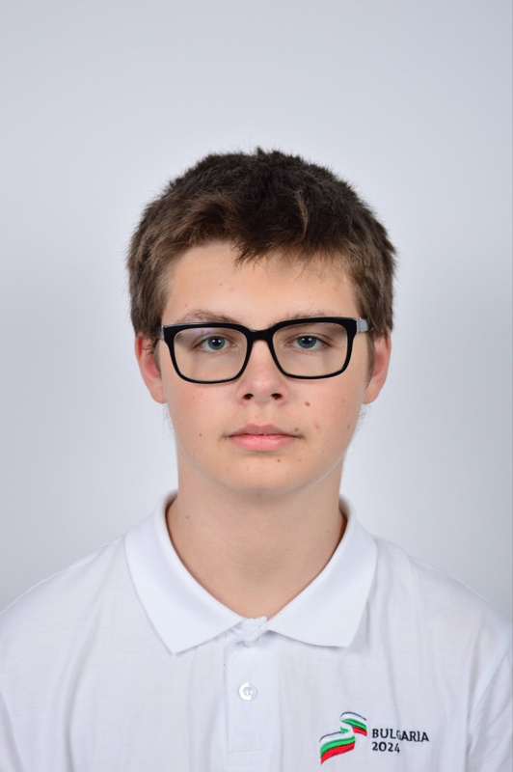
BULGARIA - CAUGHT FATAL SIGNAL
SIGABRT SIGBUS
BULGARIAN NATIONAL INFORMATICS COMMITTEE
IVAN LUPOV
TEAM LEADER
BOYAN BOYADZHIEV
MARTIN CHAVDAROV
DANIEL
GETOV
KIRIL
ZULYAMSKI

Slide 15
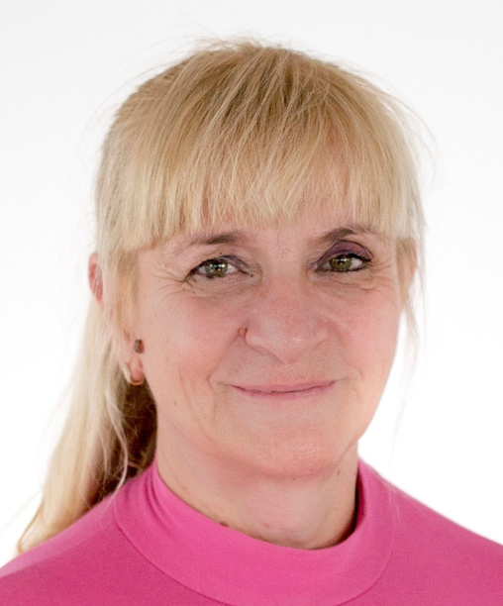
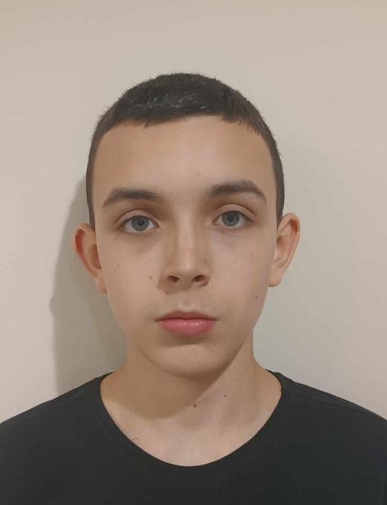
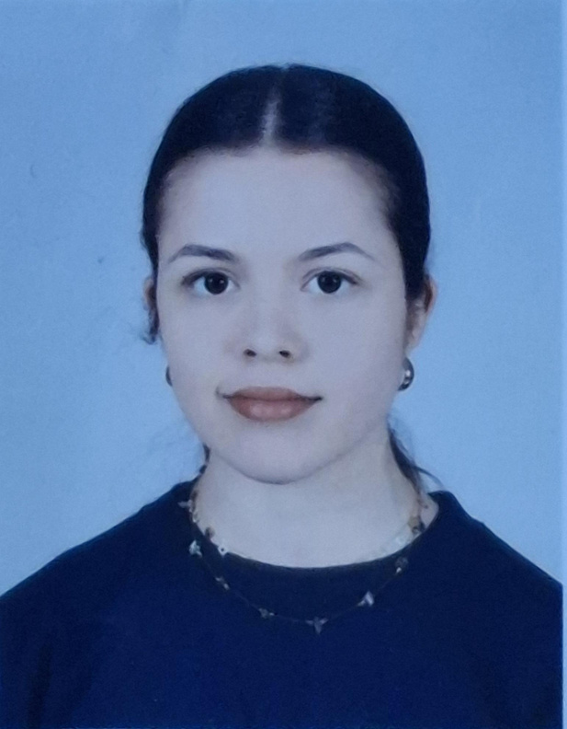
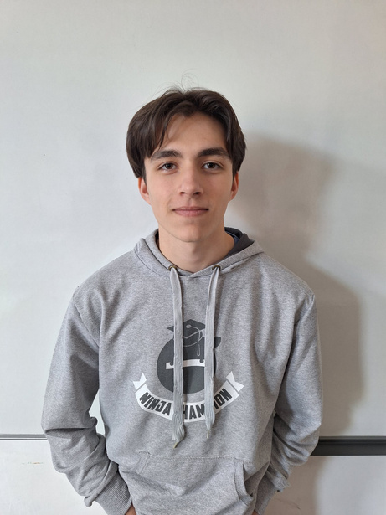
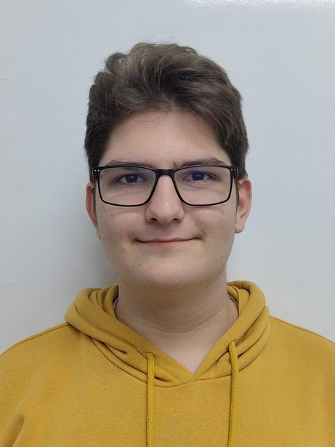
BULGARIA - THE MACHINES 🐢
BULGARIAN NATIONAL INFORMATICS COMMITTEE
BISERKA YOVCHEVA TEAM LEADER
NIKOLAY VENELINOV VALCHANOV
SIMONA HRISTOVA
VLADISLAV KOSTOV
YAVOR TOSHKOV VASILEV

Slide 16

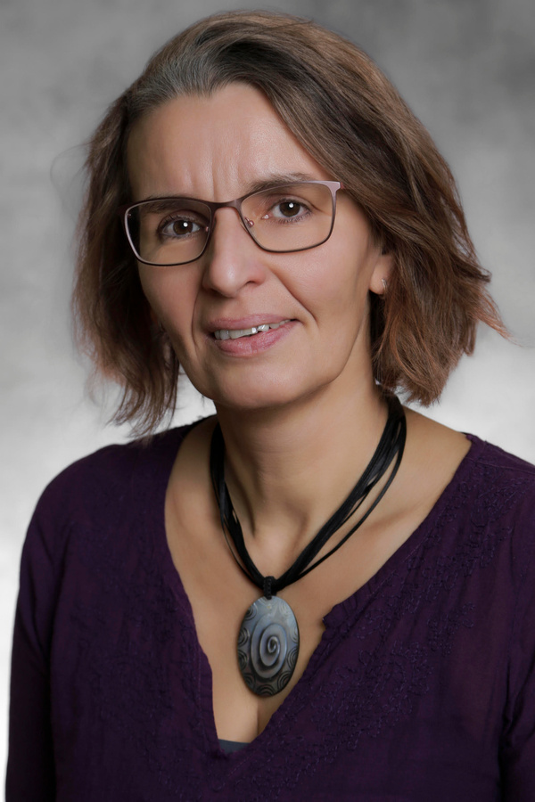
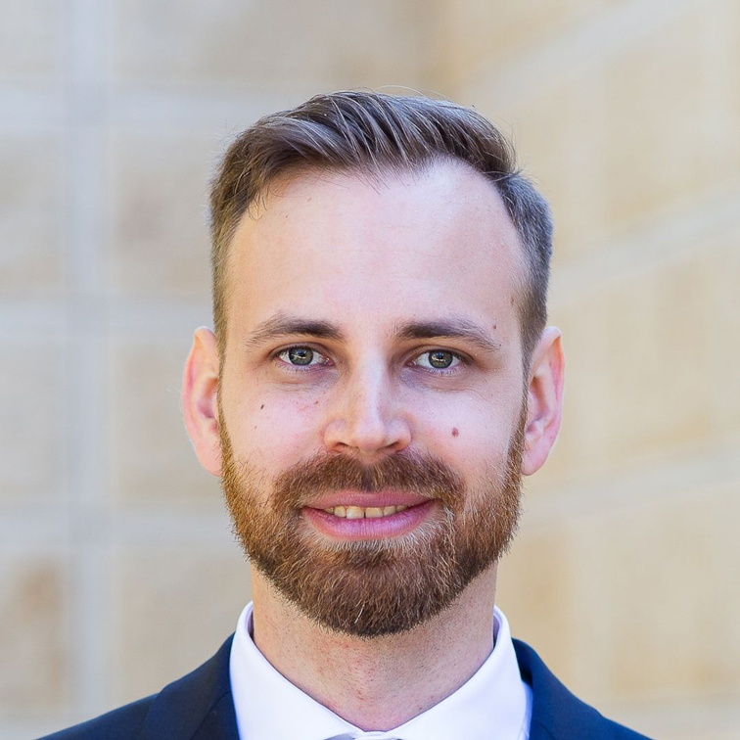
HUNGARY
COMMITTEE MEMBERS
GABRIELLA BLÉNESSY
LÁSZLÓ NIKHÁZY

Slide 17
COMMITTEE MEMBERS
Gabriella Blénessy
School/Organization: Budapesti Fazekas Mihály Gimnázium
National representative

Slide 18
COMMITTEE MEMBERS
László Nikházy
School/Organization: Debreceni Fazekas Mihály Gimnázium
International coordinator

Slide 19
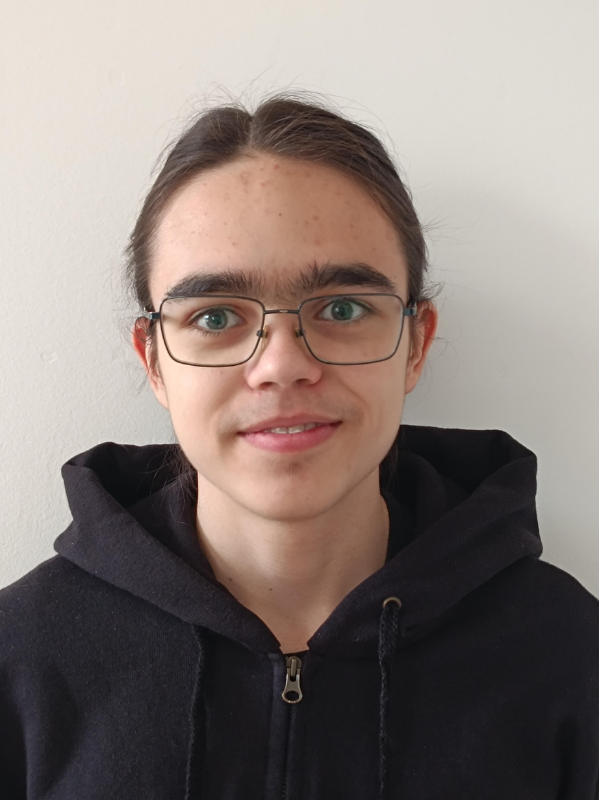
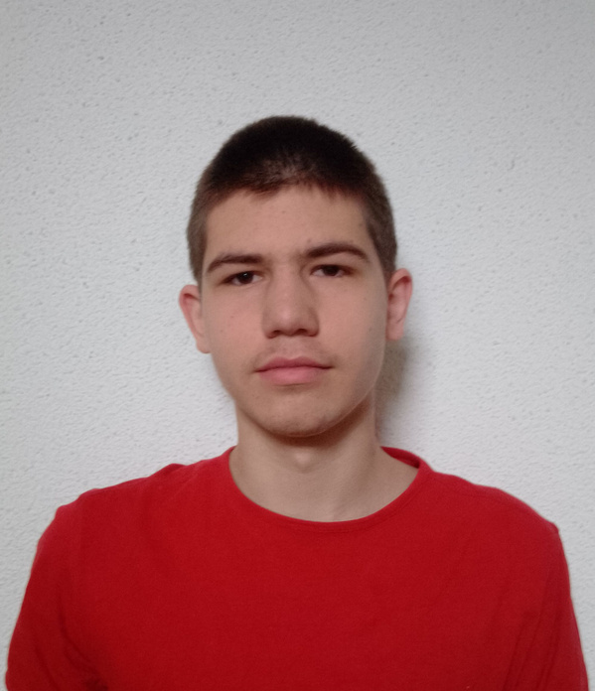
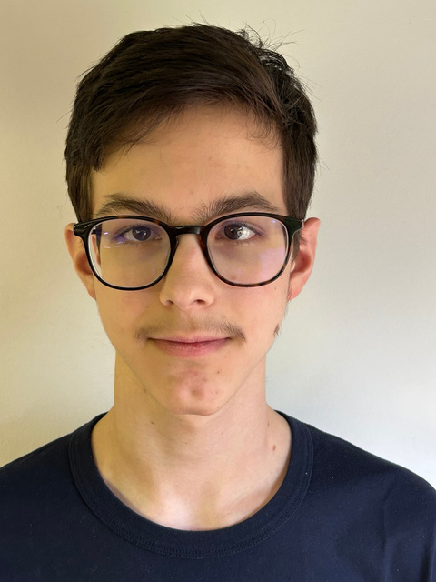
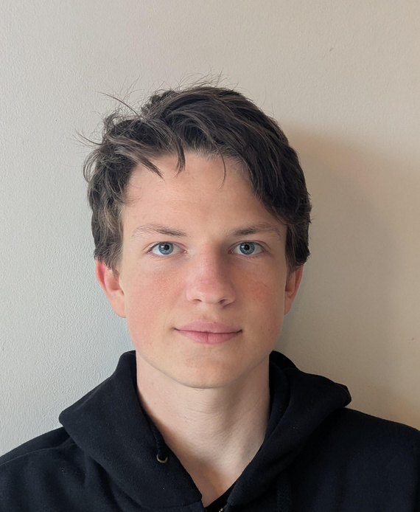
HUNGARY - OKOSTOJÁS RÁNTOTTA
BUDAPESTI FAZEKAS MIHÁLY GIMNÁZIUM
GABRIELLA BLÉNESSY
TEAM LEADER
IGNÁC BALLA
HORKA FAJSZI
GERGELY SZABÓ
BENEDEK SZASZKÓ

Slide 20
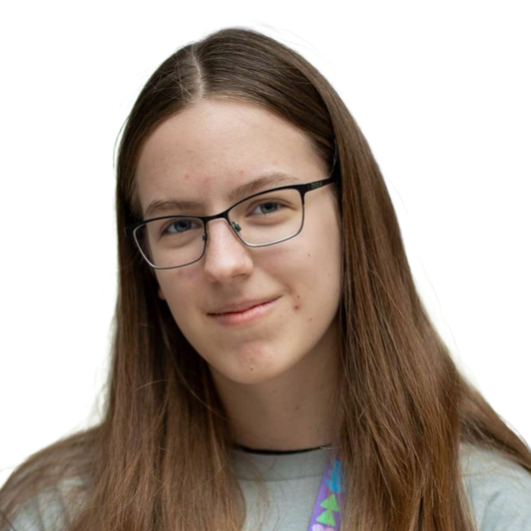
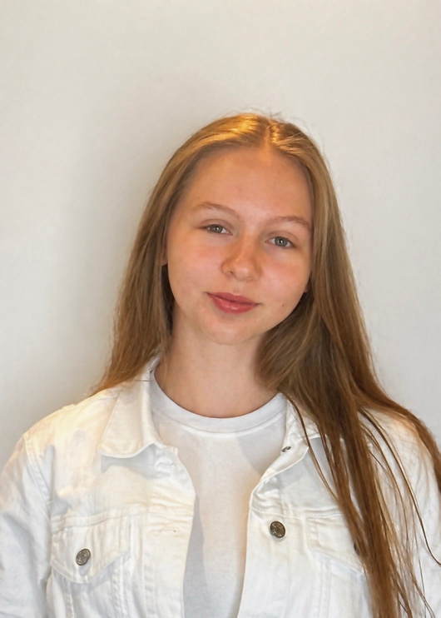
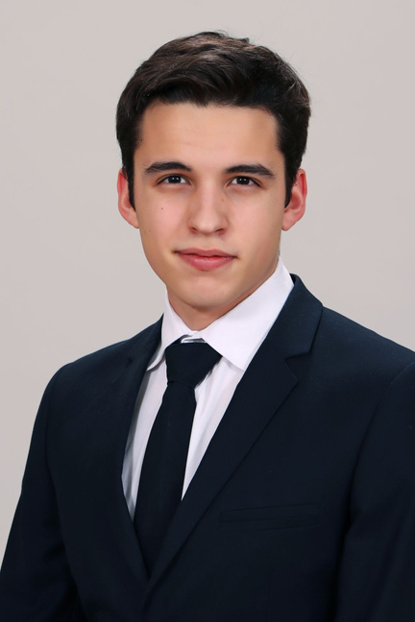
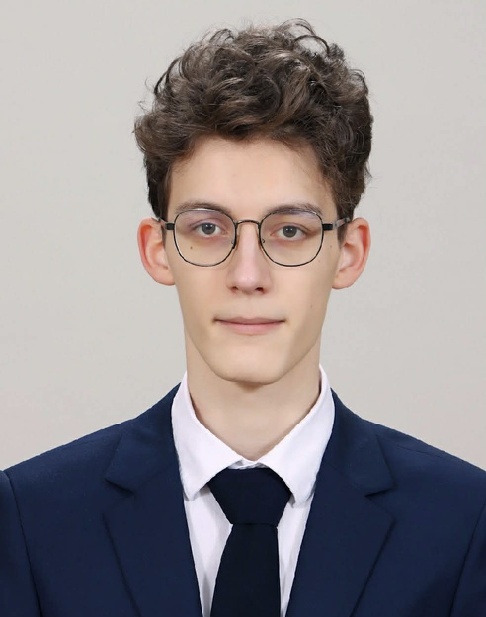
HUNGARY - AZ IGAZI FAZEKAS
DEBRECENI FAZEKAS MIHÁLY GIMNÁZIUM
LÁSZLÓ NIKHÁZY
TEAM LEADER
JÚLIA BARAN
NOÉMI BODOR
GÖRÖMBEY TAMÁS
BENDEGÚZ PÉTER VÁMOSI

Slide 21

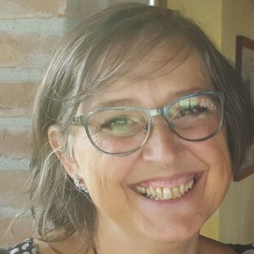
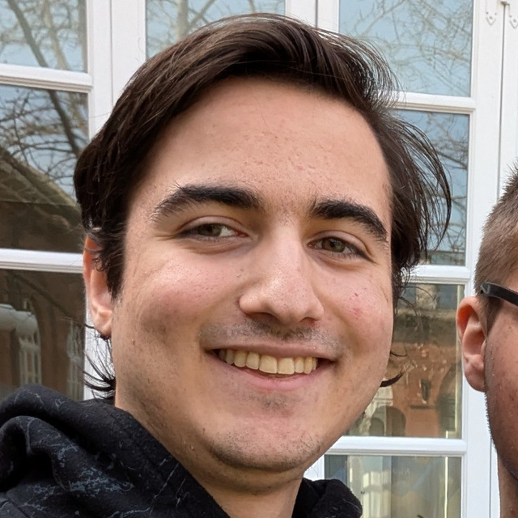
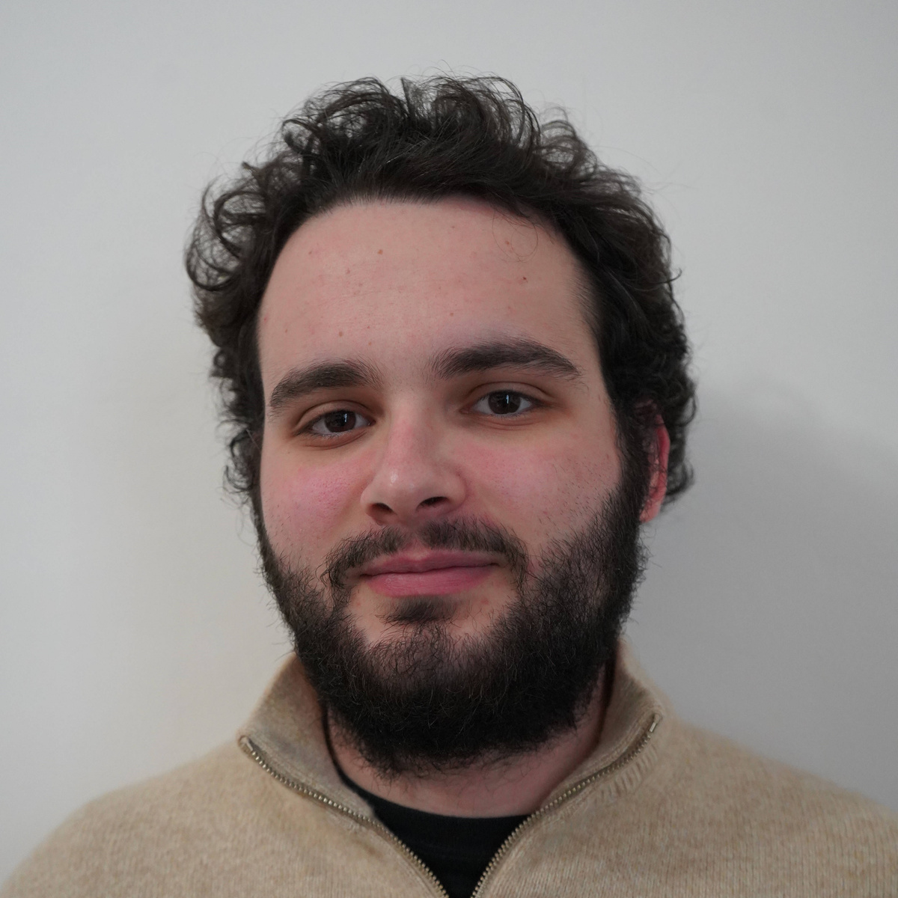
ITALY
COMMITTEE MEMBERS
NADIA AMAROLI
ALESSANDRO FARCAS
MATTEO ZANNINI

Slide 22
COMMITTEE MEMBERS
Nadia Amaroli
School/Organization: IIS ALDINI VALERIANI
National representative

Slide 23
COMMITTEE MEMBERS
Alessandro Farcas
School/Organization: OIS
Scientific coordinator

Slide 24
COMMITTEE MEMBERS
Matteo Zannini
School/Organization: IIS Aldini Valeriani
National representative

Slide 25

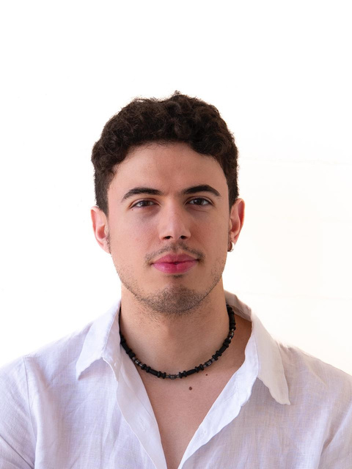
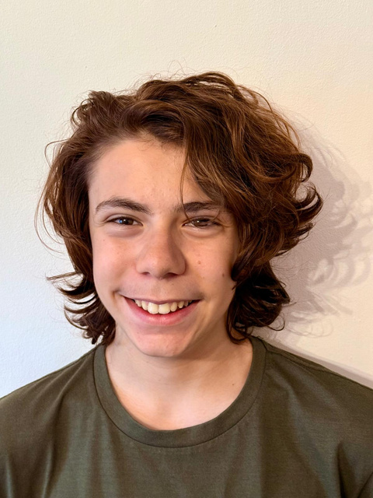
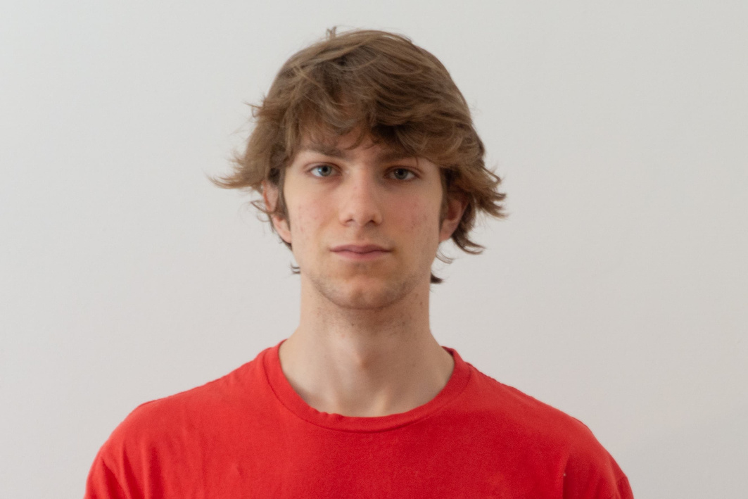
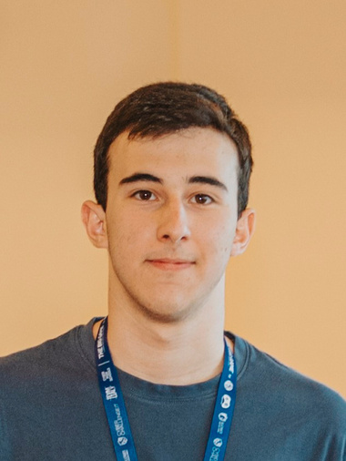
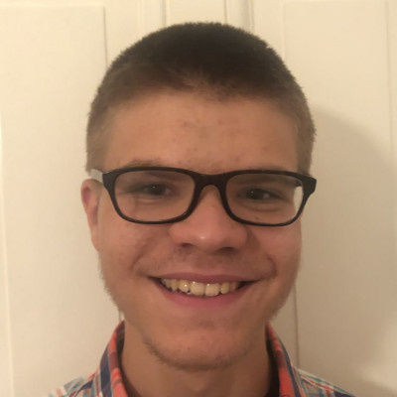
ITALY - EBESFENOMEGALODANTE
LICEO SCIENTIFICO STATALE ALESSANDRO VOLTA
IYED BOUSSAA
TEAM LEADER
ANDREA E. BARBIERI
DANIELE DI NICOLA CARENA
GIOVANNI MAIELLARO
NICOLA DINDO

Slide 26
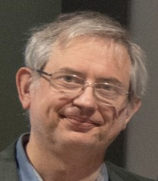
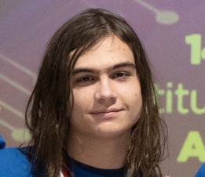
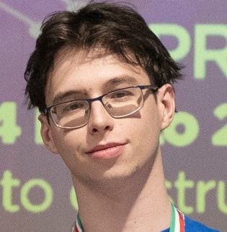
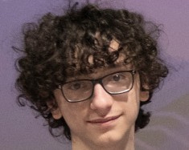
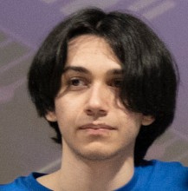
ITALY - SORT(ILEGIO)
LICEO BANFI - VIMERCATE
PAOLO MAZZA
TEAM LEADER
NICHOLAS BAMBER
ROBERTO BOZZINI
MARCO GAMBARO
GIOELE TESTA

Slide 27
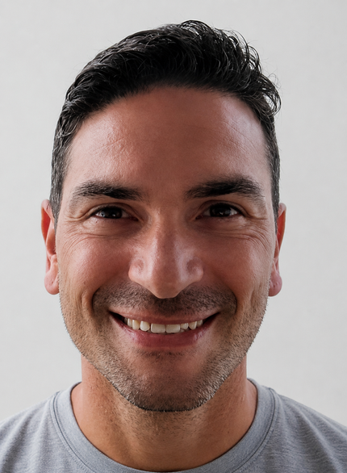
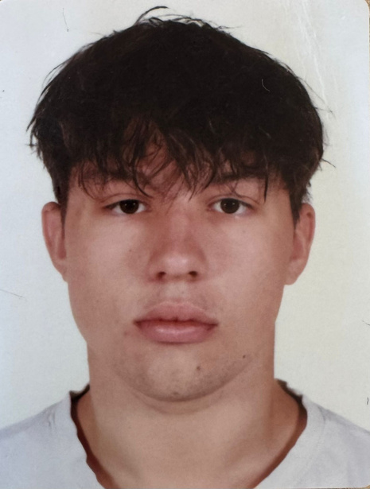
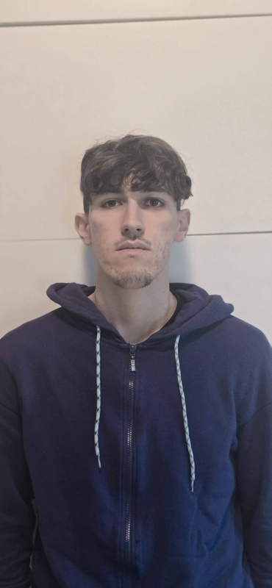
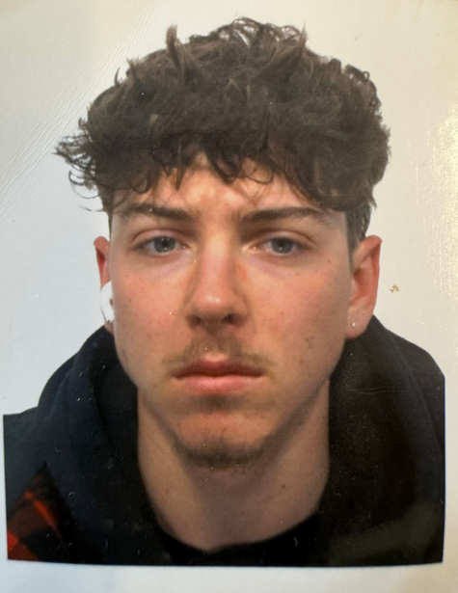
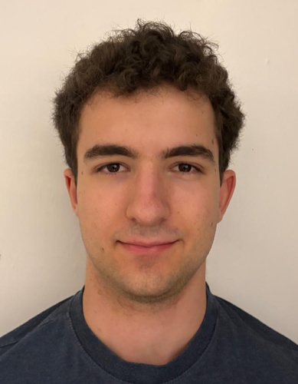
ITALY - LE FURIE DELL'AVBO
I.I.S. ALDINI VALERIANI
TONINO PETRULLI
TEAM LEADER
ANDREA CAVALLI
DENNIS CAPONE
ERNESTO SOVERINI
MICHELE FABBRI

Slide 28

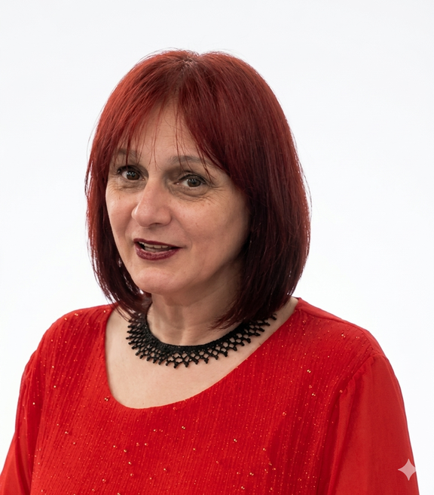
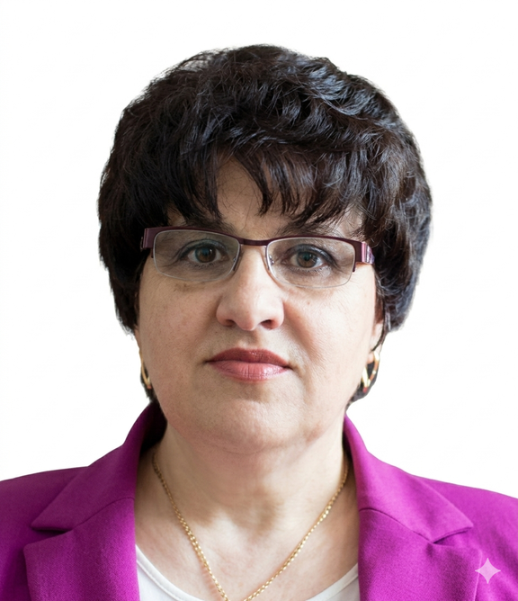
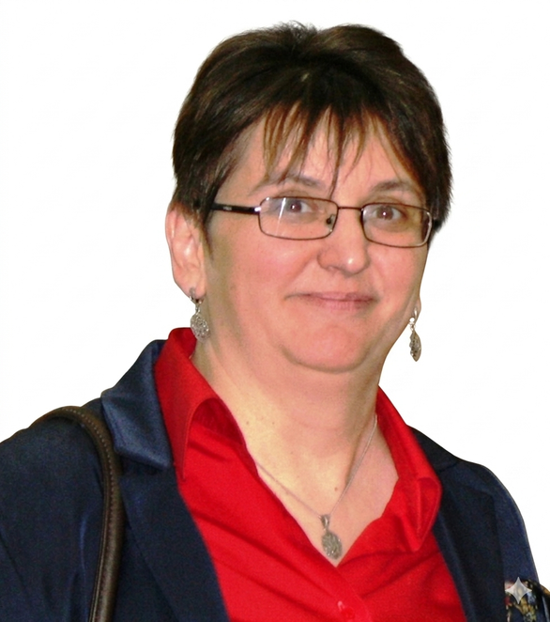
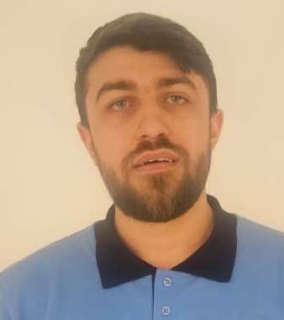
ROMANIA
COMMITTEE MEMBERS
GEORGETA ANTONIA RODICA CRĂCIUNESCU
FLORENTINA UNGUREANU
DANIELA NEAMȚU
ȘTEFAN COSMIN DĂSCĂLESCU

Slide 29
COMMITTEE MEMBERS
Georgeta Antonia Rodica Crăciunescu
School/Organization: Ministry of Education and Research
Representative of The Ministry of Education and Research

Slide 30
COMMITTEE MEMBERS
Florentina Ungureanu
School/Organization: Neamt County School Inspectorate
National representative

Slide 31
COMMITTEE MEMBERS
Daniela Neamțu
School/Organization: National College of Computer Science
Principal of Leader School, National College of Computer Science

Slide 32
COMMITTEE MEMBERS
Ștefan Cosmin Dăscălescu
School/Organization: Algolymp
National representative

Slide 33
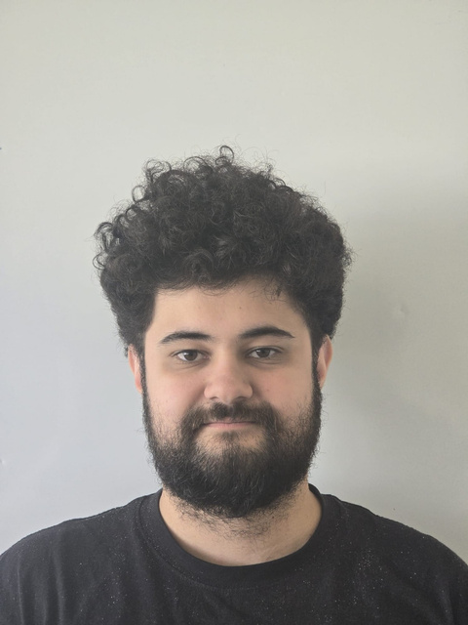
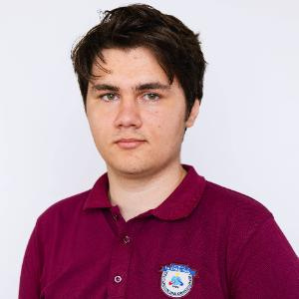
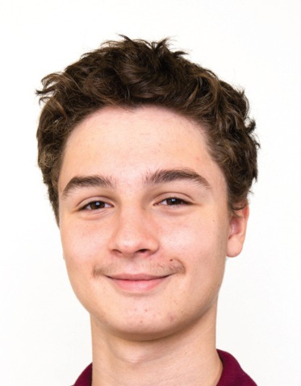
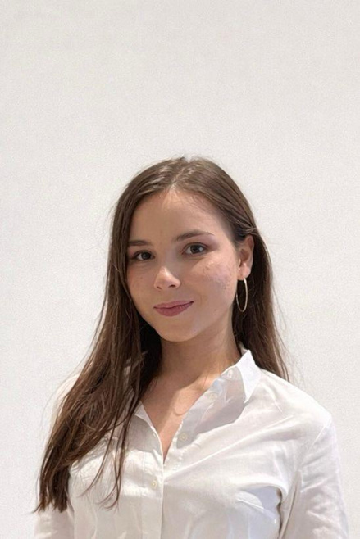
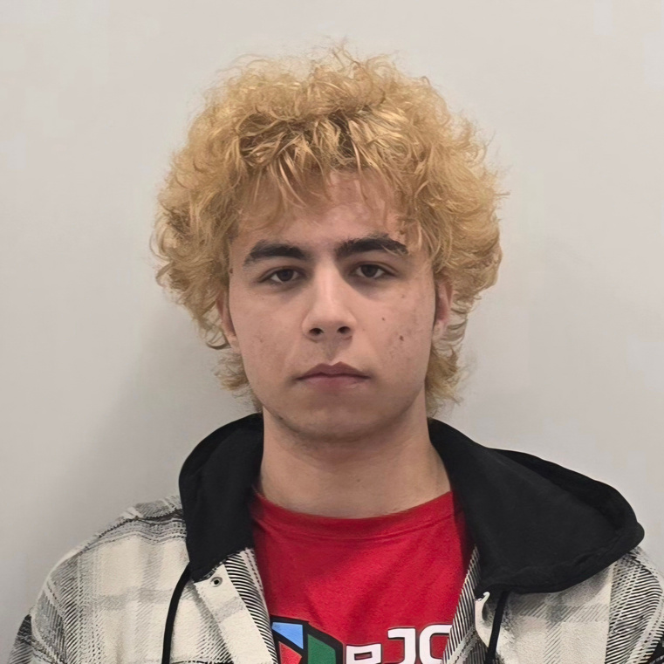
ROMANIA – MELONEE
INTERNATIONAL COMPUTER SCIENCE HIGH SCHOOL BUCHAREST
CASIAN PĂTRĂȘCANU TEAM LEADER
IANIS BELU
IANCU-IOAN SANDEA
MIHAI-VALERIU VOICU
IOANA STROE

Slide 34
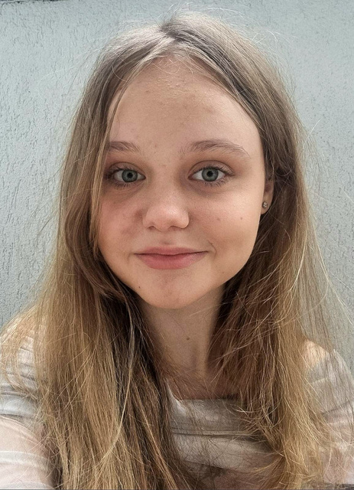



ROMANIA – NE TREBE FANTA
INTERNATIONAL COMPUTER SCIENCE HIGH SCHOOL OF BUCHAREST
CASIAN PĂTRĂȘCANU TEAM LEADER
CARINA-MARIA VIESPESCU
EMA NICOLE GHEORGHE
MATEI NEACȘU
DAVID-VLAD MĂRGHIDAN

Slide 35





ROMANIA – SSKMF
NATIONAL COLLEGE OF COMUPTER SCIENCE PIATRA-NEAMȚ
ELENA COSTRACHEVICI
TEAM LEADER
DARIA MOVILĂ
GABRIEL LUNCANU
SAMUEL ȘOIMARU
ȘTEFAN-MIHAI FILIMON

Slide 36





ROMANIA – MELONIE (GUEST TEAM)
"TUDOR VIANU " COMPUTER SCIENCE NATIONAL COLLEGE
ELENA DRĂGAN TEAM LEADER
ANA GABRIELA DUMITRESCU
MIRCEA MAXIM REBENGIUC
TUDOR ȘTEFAN GRECU
VLAD ANDREI DOBROMIR

Slide 37




ROMANIA – POMELO (GUEST TEAM)
"TUDOR VIANU " COMPUTER SCIENCE NATIONAL COLLEGE
ELENA DRĂGAN TEAM LEADER
ANDREI PAUL IORGULESCU
DOMINIC MOHANU
DRAGOȘ GIUȘCĂ
LAURA MOLDOVAN

Slide 38




SYRIA
COMMITTEE MEMBERS
ABDULRAHMANA HDALI
AMMAR ALNAHHAS
BERNARD IBRAHIMCHA

Slide 39
COMMITTEE MEMBERS
Abdulrahman Ahdali
School/Organization:
Destination and Creativity Agency
Headmaster

Slide 40
COMMITTEE MEMBERS
Ammar Alnahhas
School/Organization:
Destination and Creativity Agency
National representative

Slide 41
COMMITTEE MEMBERS
Bernard Ibrahimcha
School/Organization:
Noon E. Commerce
Scientific coordinator

Slide 42





SYRIA – THE GOOD TEAM
ON-LINE
DISTINCTION AND CREATIVITY AGENCY (DCA)
AMMAR ALNAHHAS
TEAM LEADER
ABDALRHMAN SFAR
FOAD HAWARI
HADI SULEIMAN
IBRAHEM FOSTOK

Slide 43




SYRIA – IAY MI AMOR, AY MI AMOR!
DISTINCTION AND CREATIVITY AGENCY (DCA)
ON-LINE
ABDULRAHMAN AHDALI
TEAM LEADER
MOHAMAD DIAA SROUJI
MOHAMAD ADEEB OBEIDO
M-ANAS HAJJAR
RAMZI ALLWLW

Slide 44



UNITED STATES OF AMERICA
COMMITTEE MEMBERS
ADAM KARPF
DYLAN KARPF

Slide 45
COMMITTEE MEMBERS
Adam Karpf
School/Organization:
United States of America Informatics Olympiad in Teams
Teacher of the leader school

Slide 46
COMMITTEE MEMBERS
Dylan Karpf
School/Organization:
United States of America Informatics Olympiad in Teams
National representative

Slide 47




UNITED STATES OF AMERICA –
THE ANTI-BUG ALLIANCE
DISTINCTION AND CREATIVITY AGENCY (DCA)
DYLAN KARPF
TEAM LEADER
ANDREEA PASCA
HELEN PENG
IRVIN WANG
NATHAN HUANG

Slide 48
GUEST TEAMS

Slide 49





CHINA - SHANGHAI STARRIVER BILINGUAL SCHOOL
ON-LINE
SHANGHAI STARRIVER BILINGUAL SCHOOL
CHANGLIN LIU
TEAM LEADER
REN JIE QIU
YUEZHE TAN
YUWEI LI

Slide 50







GEORGIA - GEORGIAN STARS
EUROPEAN EDUCATION CENTER
NICOLOZ PRUIDZE
TEAM LEADER
ANDRIA KOSTAVA
GIORGI BULAURI
TAMAZI BENDIANISHVILI
SABA GODUADZE

Slide 51






ISRAEL - CPPRINCES
ISRAEL'S COMPUTER SCIENCE TEAM
RAZ DVORA TEAM LEADER
AMIR KRISPIN
DANIEL PRINESS
MATAN HAREL
MAYA COHEN

Slide 52





KINGDOM OF SAUDI ARABIA – MISKALIANS
MISK SCHOOLS
ON-LINE
TURKI ALSULTAN
TEAM LEADER
ABDULLAH MOKHTAR A ALRUWAIS
KHALID MOHAMMAD S ALABDULLATIF
MOHAMMAD KHALID M ALADAILI

Slide 53






MOLDOVA - TECH FUSION
ORIZONT LYCEUM
SERGIU CORLAT TEAM LEADER
ALIN POPESCU
DAN SANDU
OCTAVIAN HARCEL
ROBERT BARBUȚA

Slide 54





MOLDOVA - ALGORITHMICS
ORIZONT LYCEUM
NICHITA NARTEA TEAM LEADER
ALEXEI BACA
ANASTASIA CORSAC
ANDREEA ȘANDREAN
ALEXANDRA KIRILLOV

Slide 55





SLOVAKIA - GAMČÁCI
GRÖSSLINGOVÁ 18, BRATISLAVA
ON-LINE
MICHAL ANDERLE
TEAM LEADER
MARIÁN KOVAĽ
MATEJ CISKO
ŠTEFAN MIKULAJ
OLEKSII KATAIEV

Slide 56




SLOVAKIA – GAMČÁCI2
GRAMMAR SCHOOL, GRÖSSLINGOVÁ 18, BRATISLAVA
ON-LINE
MICHAL ANDERLE
TEAM LEADER
MATÚŠ FÜLÖP
JAKUB HLADÍK
VIOLA LEPEJOVÁ
RADKO BÁBÍČEK

Slide 57





SWEDEN - VI TÄVLAR FRÅN GÖTEBORG!!!
KODSPORT SVERIGE
ON-LINE
JOSHUA ANDERSSON
TEAM LEADER
ANNIE KARHEIDING
MARTIN ZHANG
MAX BYLUND
TEO LOVMAR
Notes:
56

Slide 58



SWEDEN - VI TÄVLAR FRÅN STOCKHOLM!!!
KODSPORT SVERIGE
ON-LINE
HARRY ZHANG
TEAM LEADER
SAMUEL BACKLUND
SAMUEL QI
SIMON PERSSON HOLM
VLADYSLAV LEVCHENKO

Slide 59






VIETNAM - VIETNAMIIOT
VAIP
ON-LINE
THUAN
DO PHAN
TEAM LEADER
DUNG NGUYEN BUI DUC
KHOA LE PHAM DUY
THANH NGUYEN XUAN CHI THANH
TUAN NGUYEN HUU

Slide 60


Slide 61


Slide 62


